Slide 1

Predictive Lead Scoring
By
Data science interns
@ NEBIANT ANALYTICS

Slide 2
Predictive Lead Scoring
Objective: Develop a predictive lead scoring model to prioritize leads based on their likelihood of conversion, enabling the sales team to focus efforts on high-value leads.

Slide 3
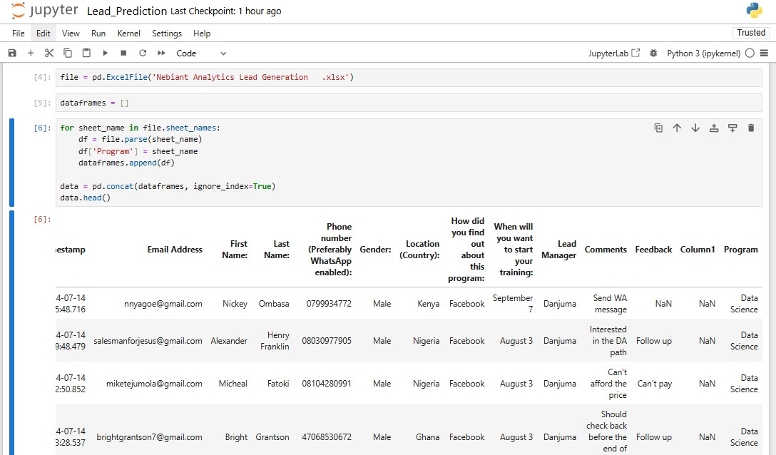
IMPORTING DATASET AND DATA PREPROCESSING

Slide 4
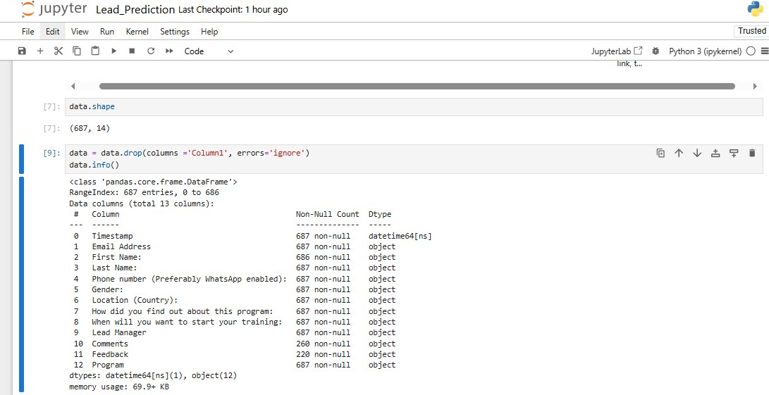

Slide 5
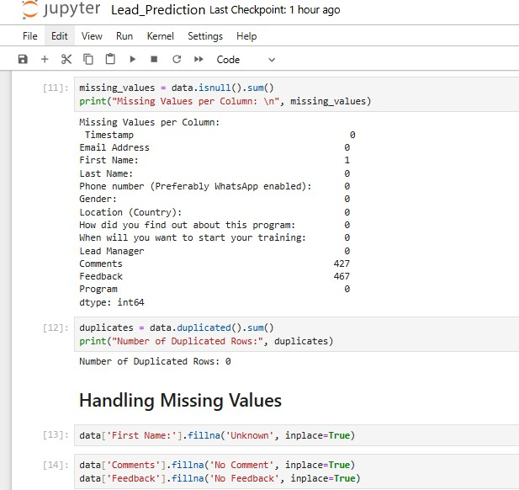

Slide 6
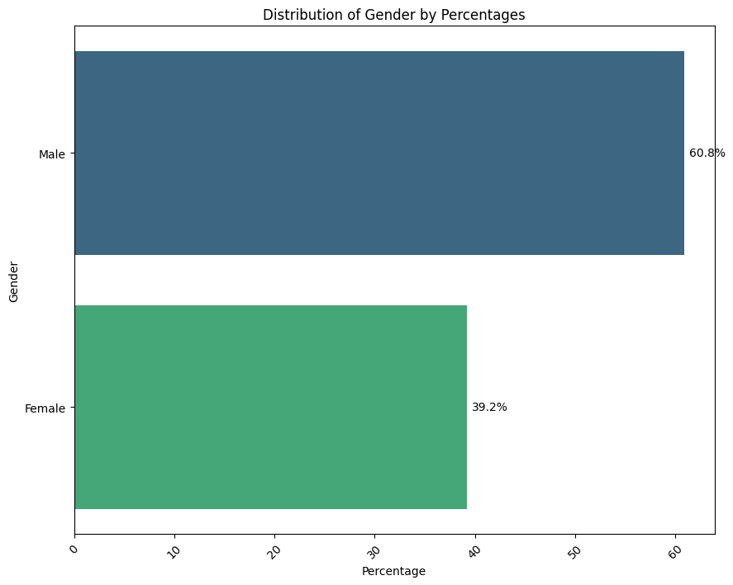
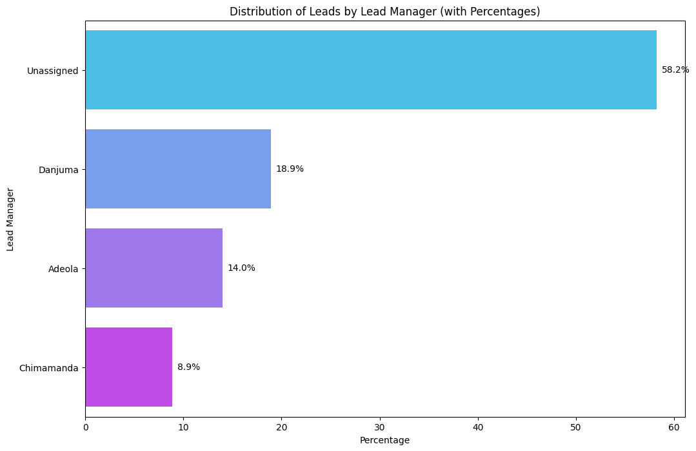
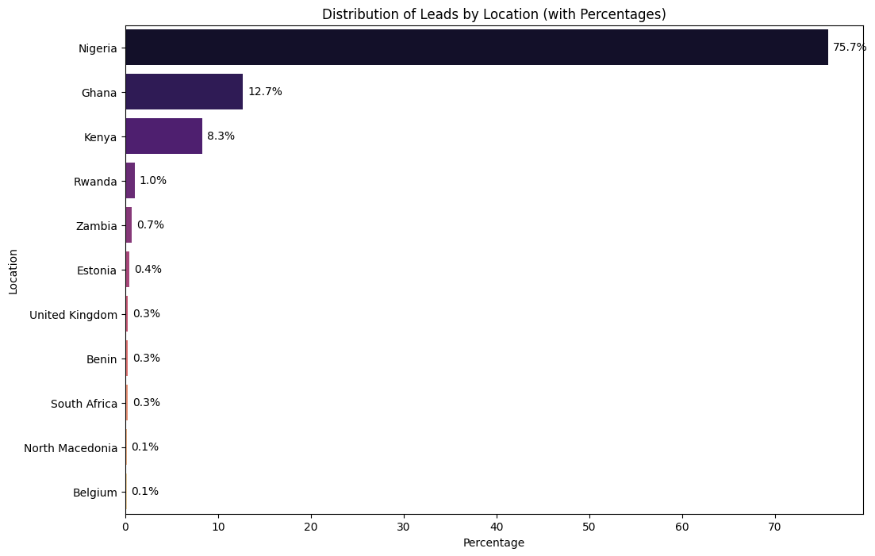
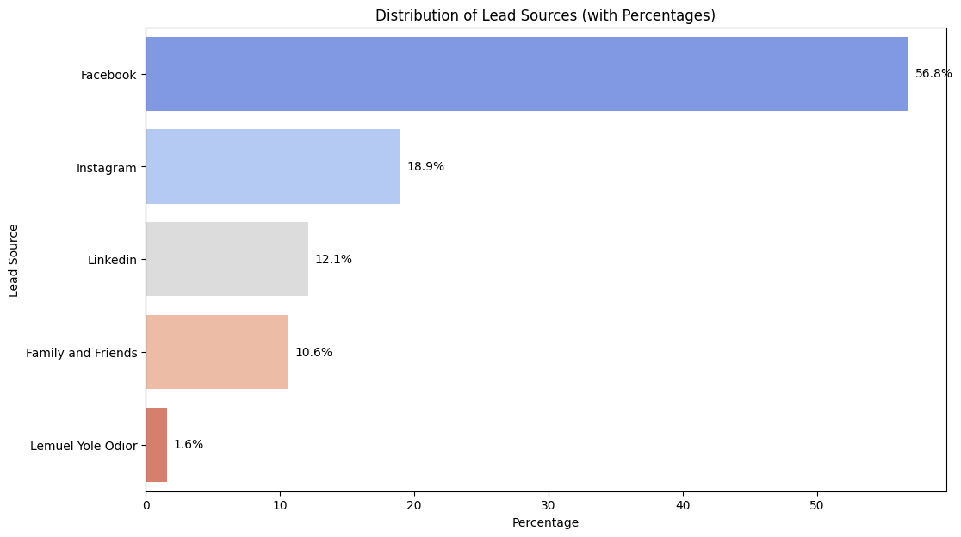
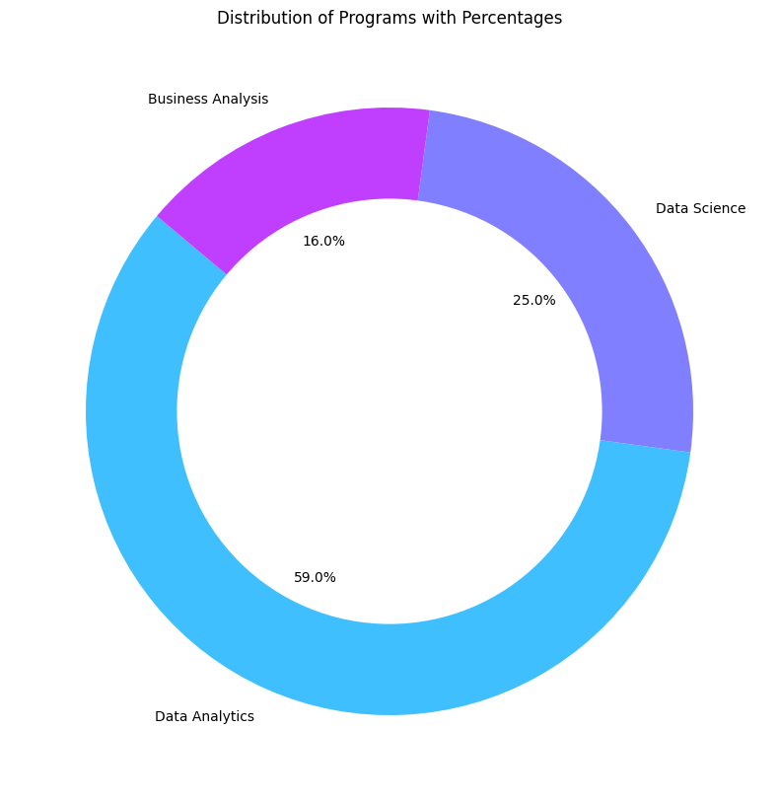
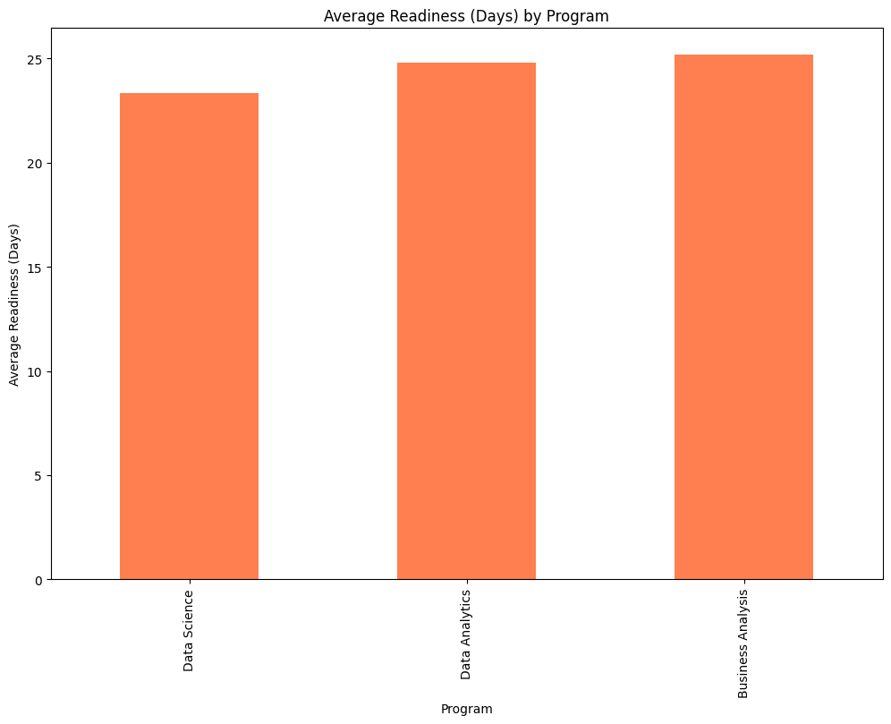
EXPLORATORY DATA ANALYSIS

Slide 7
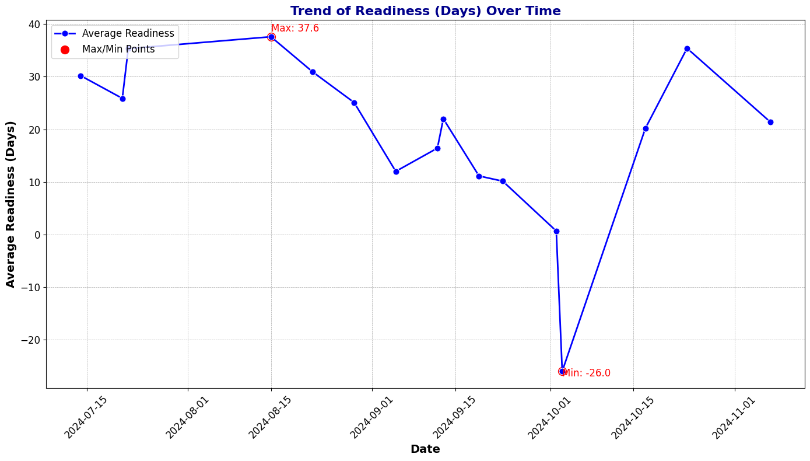

Slide 8
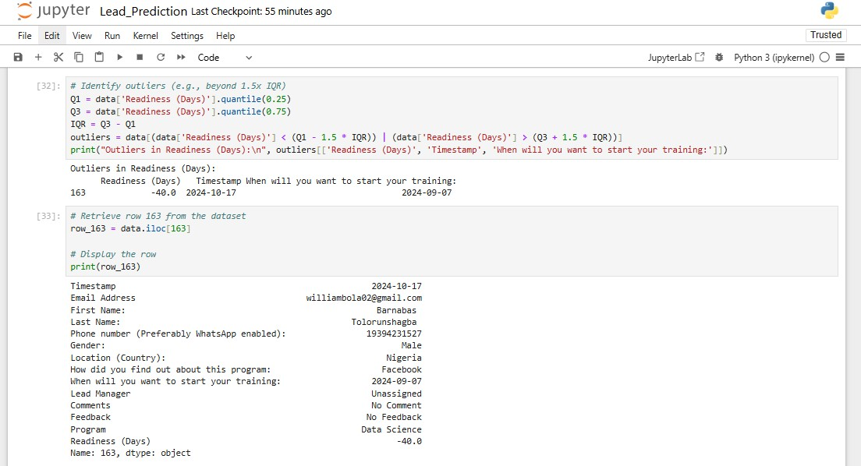

Slide 9
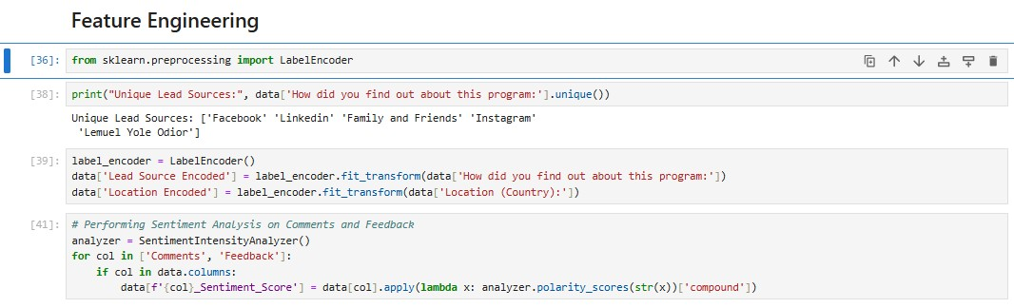
FEATURE ENGINEERING

Slide 10
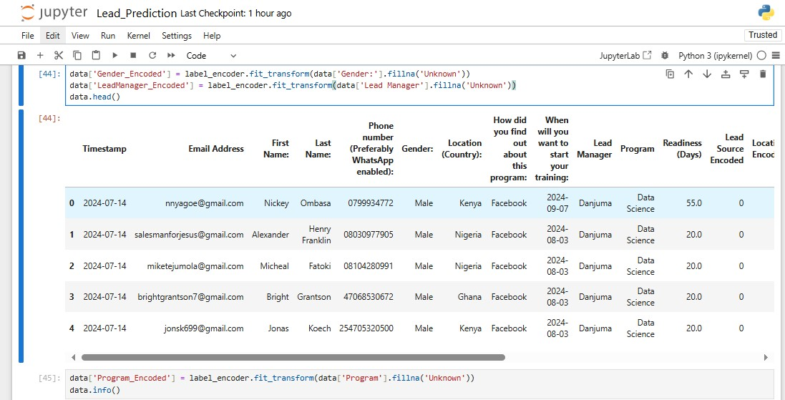

Slide 11
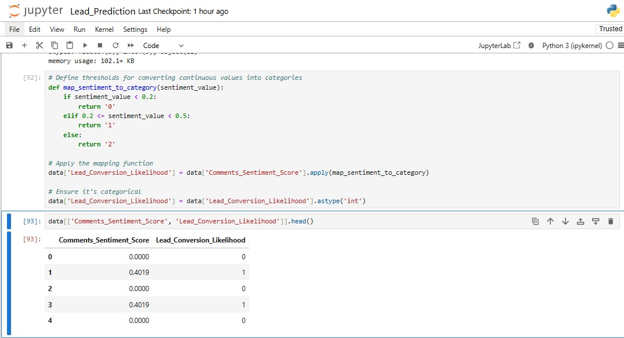

Slide 12
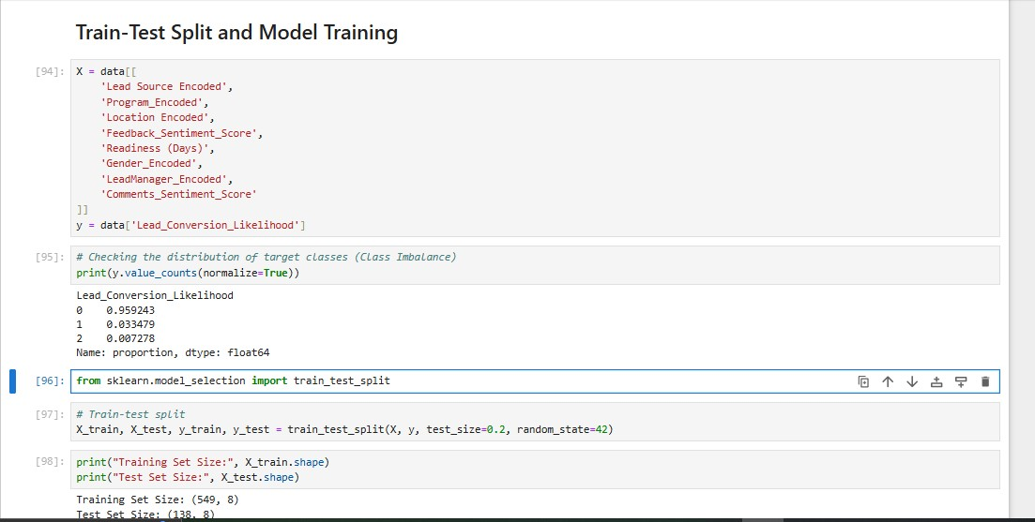
MODELLING AND DEPLOYMENT

Slide 13
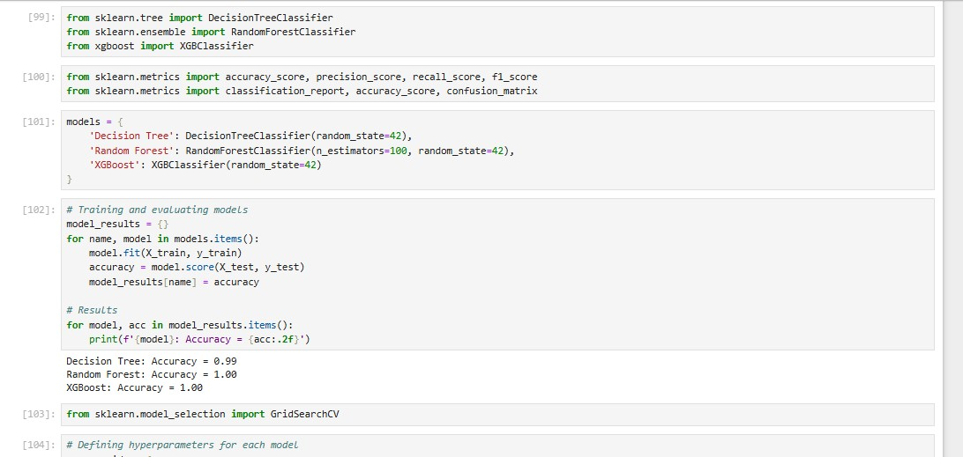

Slide 14
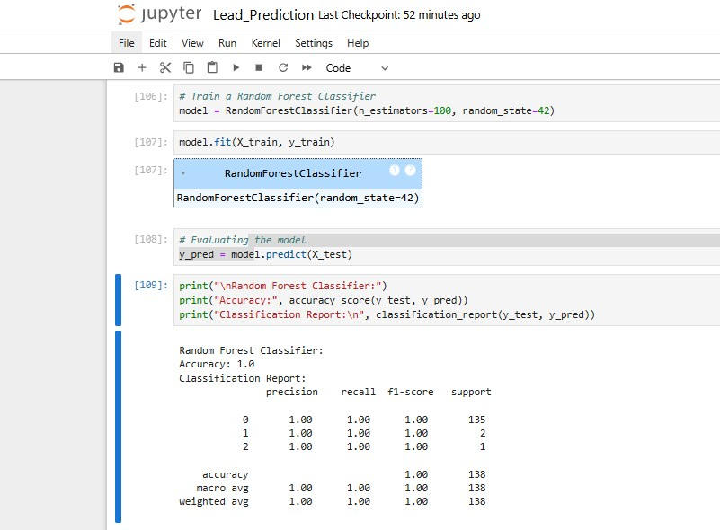

Slide 15
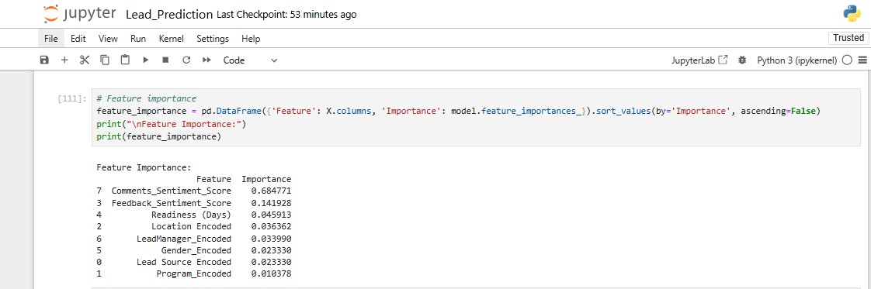

Slide 16
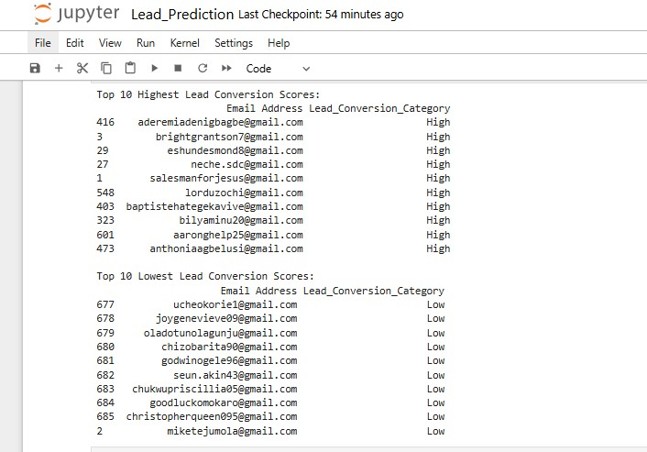

Slide 17
RECOMMENDATIONS
Our analysis has revealed that assigned leads show significantly higher conversion rates than unassigned leads. To maximize efficiency and improve conversions, we recommend implementing an automated lead assignment process, providing enhanced training to lead managers, and closely monitoring assignment timelines. This approach will ensure every lead gets the attention it needs to convert successfully.

